Slide 1
Syrian Virtual University
ITI-310
Windows Server 2008
Working with Active Directory
User Account Management

Slide 2
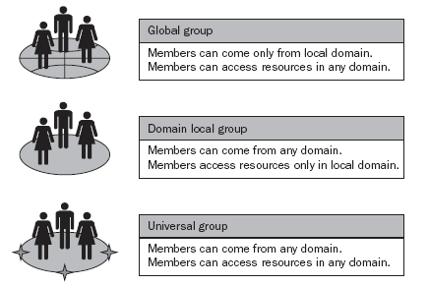
Groups
Types of Groups
  Security Groups.
  Distribution Groups.
Scopes of groups
  Global groups.
  Domain Local Groups.
  Universal Groups.

Slide 3
Groups
Built-in Groups
  Security Groups.
  Distribution Groups.
Creating Groups.
Group Information

Slide 4
User Account Management
Properties of User Accounts
  Password Security.
  Permissions.
  Identification.
  User Rights.
  Roaming.
  Environment layout.
  Auditing.

Slide 5
User Account Management
User Account Types
  Local user accounts.
    Logon/access locally/local resources
    Local security database.
    Not replicated.
    Not recognized by Domain.
  Domain user accounts.
    Logon/Access to a domain resources.
    Created in DC.
    Replicated to all DCs in the domain.

Slide 6
User Account Management
User Account Types
  Built-In user accounts
    Administrator
      Cannot: Delete, lock, disable.
      Can: Rename.
      Recommendation: Rename this account a.s.a.p.
    Guest.
      Cannot: delete.
      Can: disable, lock, rename, blank password.
      Recommendation: Disable this account.
    HelpAssistance

Slide 7
User Account Management
Creating User Account.
Tabs in user account properties.
Setting logon hours.
Setting the computers from which users can log on.
Setting account expiration date.

Slide 8
Managing User Profiles
Settings saved in a user profile (NTUser.dat).
  Start Menu configuration.
  Screen saver and wallpaper settings.
  List of recently accessed documents.
  Favorites list from Internet Explorer.
  Network mapped drives.
  Installed network printers.
  Desktop layout.
User profile types
  Local user profile.
  Roaming user profile.
  Mandatory user profile.
  Temporary user profile.

Slide 9
Managing User Profiles
Creating User profile.
  Creating Roaming User profile.
  Creating Mandatory user profile.
Home Folder
  Creating Home Folder.
Maintaining user account
  Renaming, disabling, enabling, deleting user account.
  Unlocking user account.
  Resetting password.

Slide 10
AD Backup
AD Backup
  Registry.
  COM+ class registration database.
  System tools files.
  Windows files.
  Certificate services database.
  AD, sysvol.

Slide 11
AD Restore
non-authoritative mode.
  Changes will be replicated from others DCs.
Authoritative mode
  Restored copy will be replicated to other DCs.

Slide 12
Group Policy
Group Policy Items
  Computer configuration.
  User configuration.
  Local Computer Policy/Active Directory Group Policy.

Slide 13
Group Policy
Designing Group Policy Infrastructure
Active Directory domain.
Active Directory Site.
Active Directory Organizational Units.
Active Directory Security Groups.

Slide 14
Group Policy
Create a Starter Group Policy Object
Assign a Group Policy to Users and Computers
To Active Directory Domain.
To Active Directory Site.
To Active Directory Organizational Units.
To Active Directory Security Groups.
Manage User Account Control using Group Policy

